Slide 1
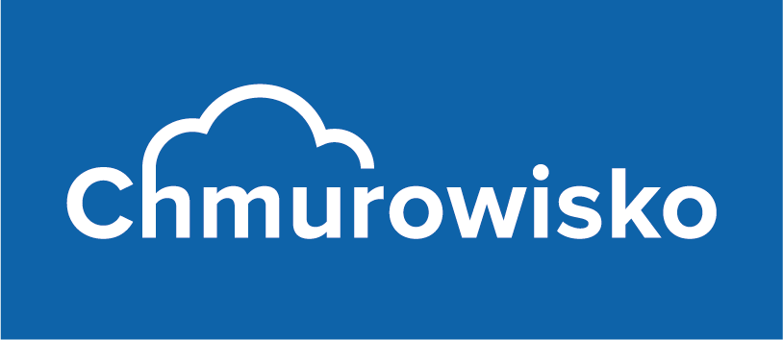
Implement Azure Active Directory
Azure Active Directory, Custom Domains, Identity Protection and MFA

Slide 2
Learning Objectives
You will learn the following concepts:
Overview of Azure Active Directory
Users and Groups
Azure AD Connect
Domains and Custom Domains
MFA
Configure Guest Users in Azure AD
Manage Multiple Directories

Slide 3
Overview of Azure Active Directory

Slide 4
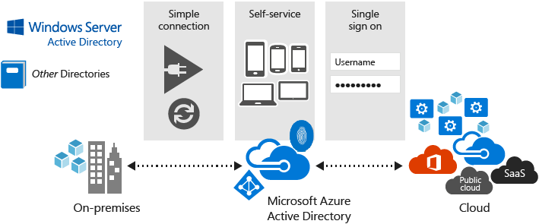
Azure Active Directory (Azure AD)
Multi-tenant cloud-based directory and identity management
Provides single sign-on access to cloud applications and resources
Facilitates developing apps with a global scope
Offers a full suite of identity management capabilities:
Self-service password and group management
Privileged account management
Role-based access control
App usage monitoring
Security monitoring
Device Registration
Alerting
Multi-Factor Authentication (MFA)

Slide 5
Azure AD Concepts
Concept | Description
Identity
Account
Azure AD Account
Azure tenant
Azure AD directory
User subscription
An object that can be authenticated.
An identity that has data associated with it.
An identity created through Azure AD or another Microsoft cloud service.
A dedicated and trusted instance of Azure AD that's automatically created when your organization signs up for a Microsoft cloud service subscription.
Each Azure tenant has a dedicated and trusted Azure AD directory.
Used to pay for Azure cloud services.

Slide 6
Azure AD Benefits
Single sign-on to any cloud or on-premises web app.
Compatible with iOS, Mac OS X, Android, and Windows devices.
Protect on-premises web applications with secure remote access.
Extend AD to the cloud.
Help protect sensitive data and applications.

Slide 7
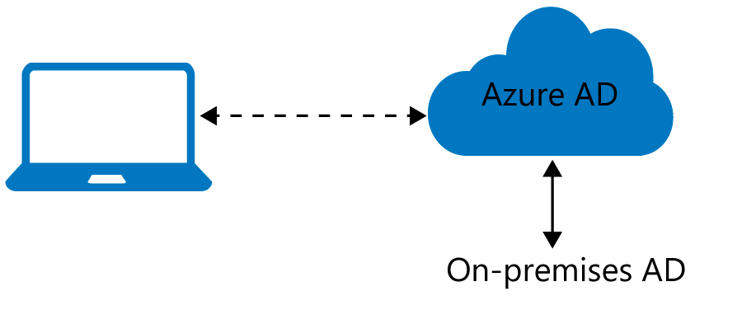
Azure AD Join
Benefits of AD Join:
Single-sign-on (SSO)
Enterprise compliant roaming
Access to Microsoft Store for Business
Windows Hello
Seamless access to on-premises resources
Connection options:
Registering
Joining

Slide 8
Users and Groups

Slide 9
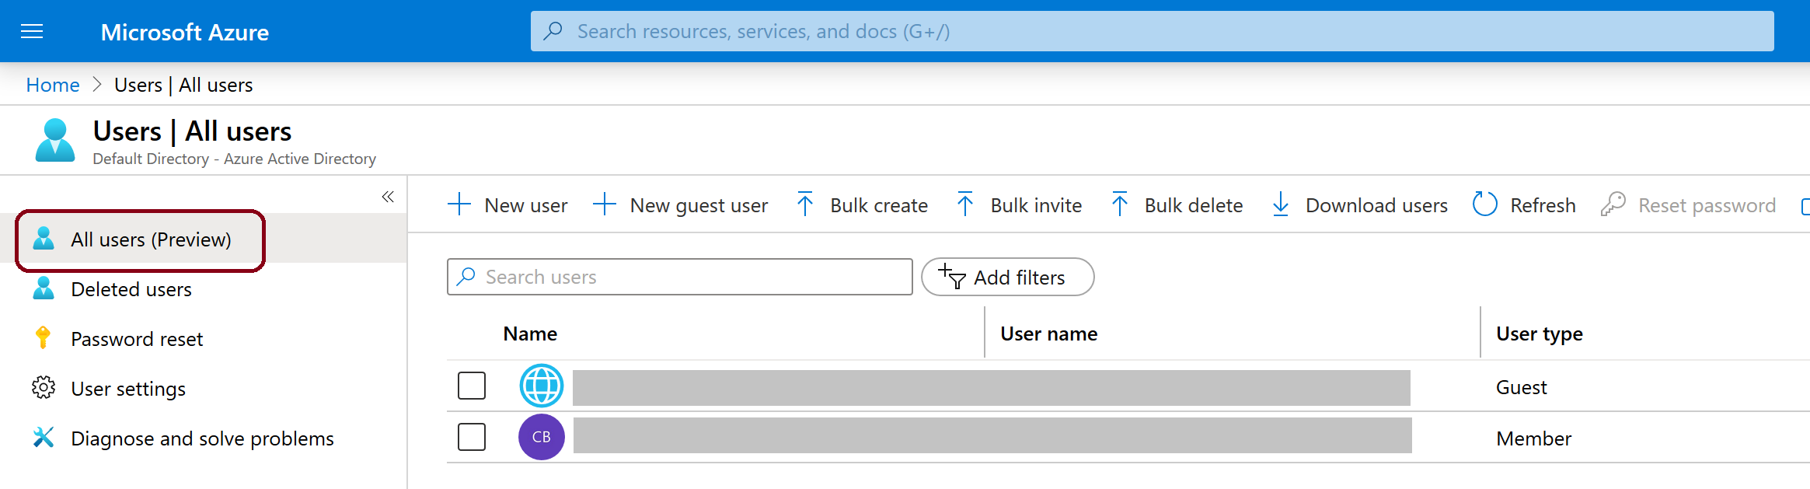
User Accounts
To view the Azure AD users, access the All users blade
Azure AD defines users in three ways:
Cloud identities
Directory-synchronized identities
Guest users

Slide 10
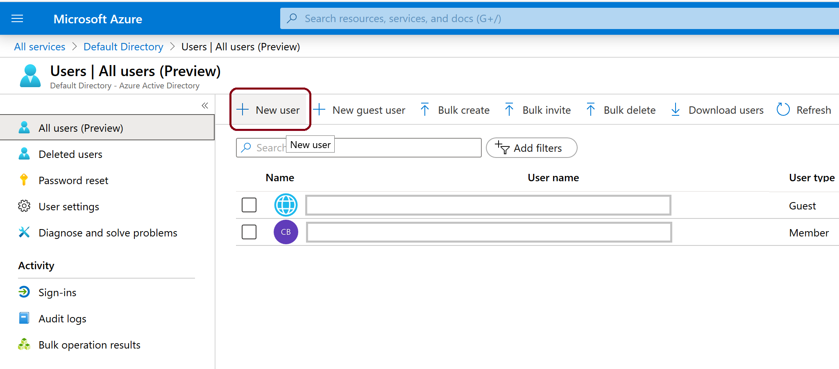
Create and Manage Users (1 of 3)
Adding users:
Synchronizing users from Windows Server Active Directory
Manually creating users by using the Azure portal

Slide 11
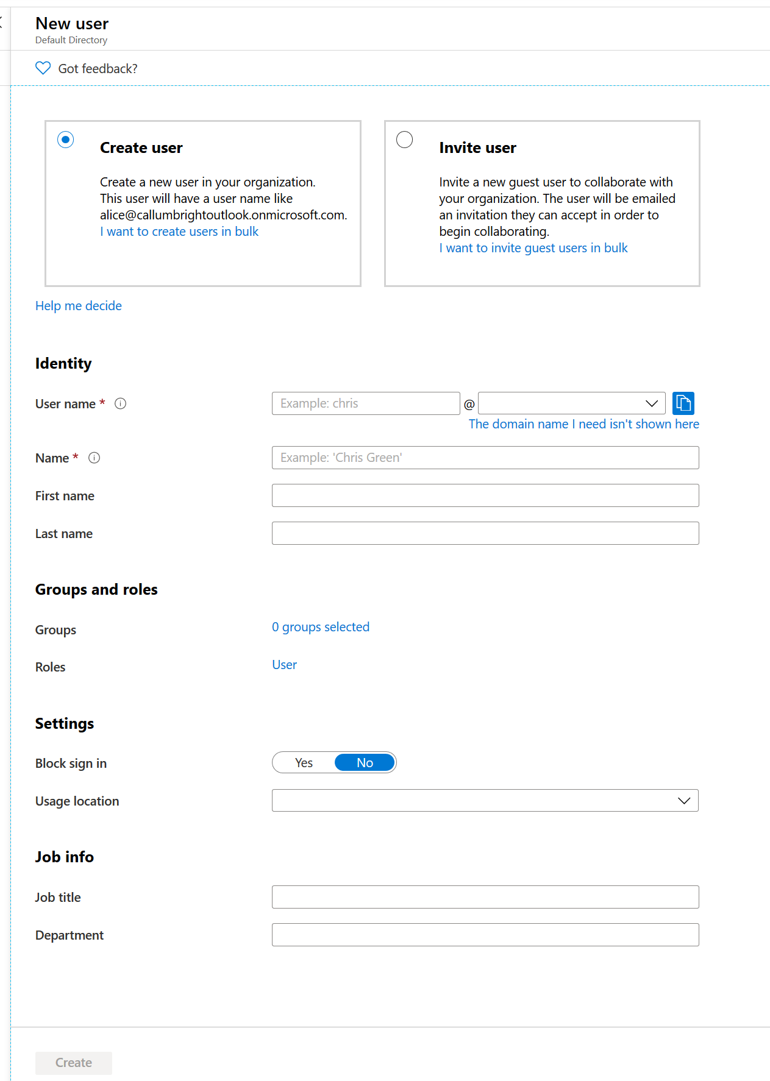
Create and Manage Users (2 of 3)
Creating a User…

Slide 12
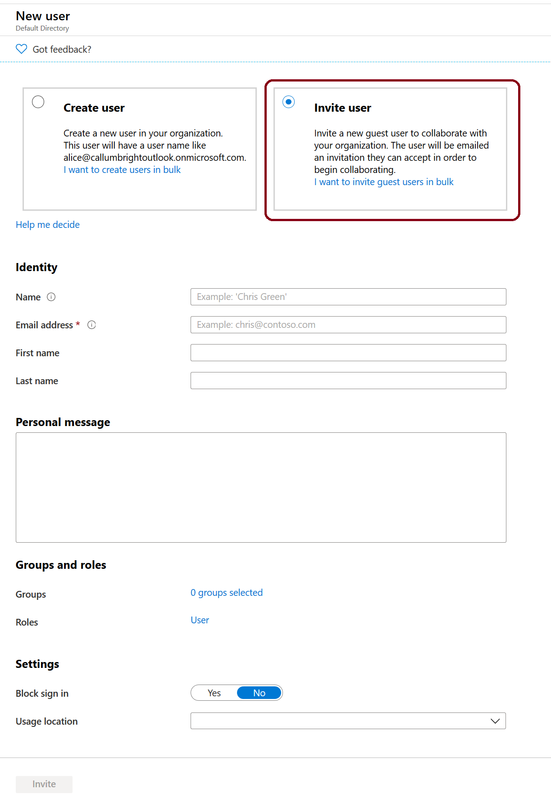
Create and Manage Users (3 of 3)
Inviting a user…

Slide 13
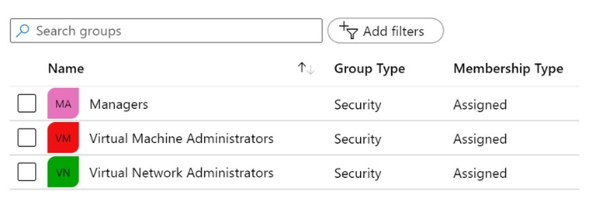
Group Accounts
You can define two different types of groups
Security groups
Office 365 groups
Adding members to groups:
Assigned
Dynamic user
Dynamic device

Slide 14
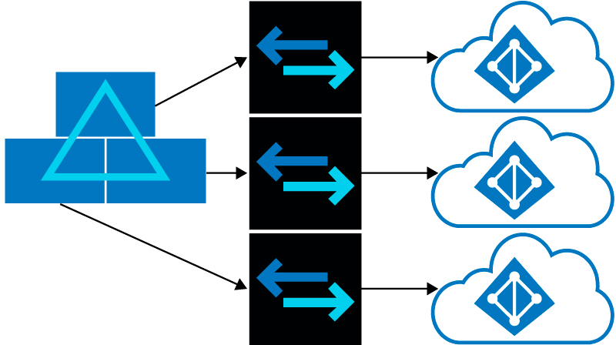
Managing Multiple Directories
Independence between tenants:
Resource independence
Administrative independence
Synchronization independence
You can create multiple Azure AD tenants

Slide 15

Azure AD Connect

Slide 16
Azure AD Connect
Why use Azure AD Connect?
Implements SSO to access on-premises applications and cloud services
Simplifies deployment experience for synchronization and sign-in
Offers the latest capabilities for your scenarios

Slide 17
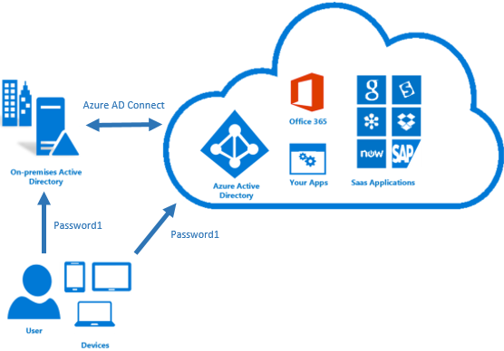
Password Synchronization
Supported by Azure AD Connect
Synchronizes user passwords from AD DS to Azure AD
Allows users to use their AD credentials in order to access:
Azure resources
Office 365
Microsoft Intune
Dynamics 365
Azure AD DS
Improves user productivity
Reduces helpdesk costs

Slide 18
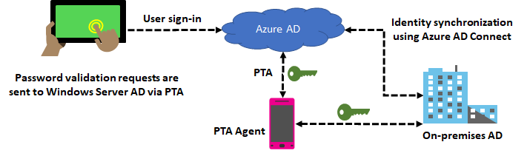
Pass-Through Authentication
Eliminates the need for password hash synchronization
Always validates credentials against Active Directory

Slide 19
Azure Active Directory Domain Services

Slide 20
Azure AD DS
Use Azure Active Directory Domain Services to join Azure virtual machines to a domain, without having to deploy domain controllers.
Take advantage of Azure Active Directory Domain Services features like domain join, LDAP, NT LAN Manager (NTLM), and Kerberos authentication, which are widely used in enterprises. Migrate legacy directory-aware applications running on-premises to Azure, without having to worry about identity requirements.
Use the Azure portal to quickly enable Azure Active Directory Domain Services for your Azure AD tenant.

Slide 21
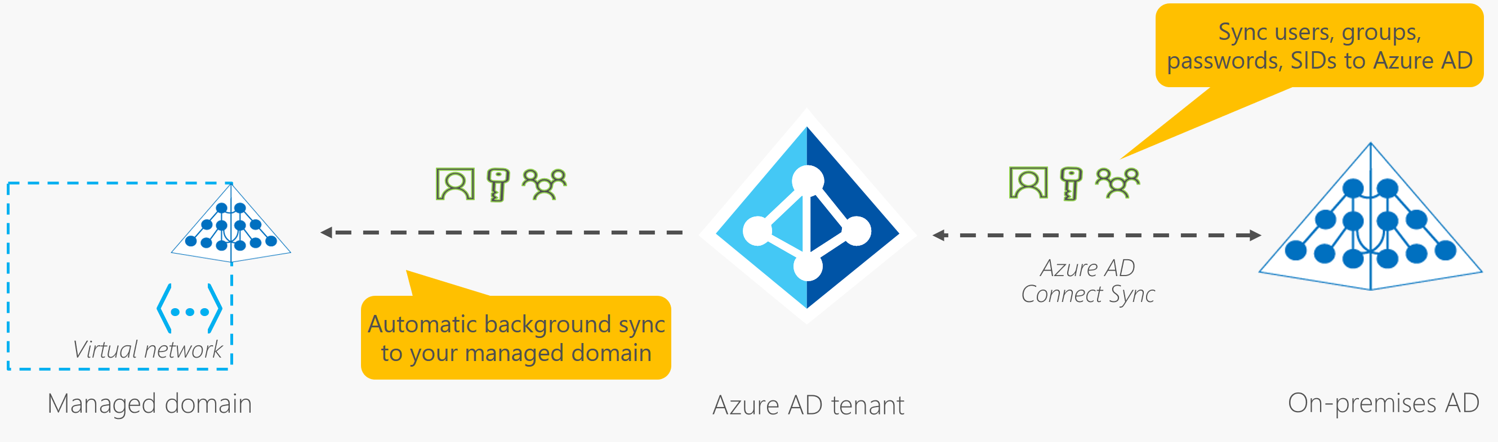
How objects and credentials are synchronized in an Azure Active Directory Domain Services managed domain

Slide 22
Domains and Custom Domains

Slide 23
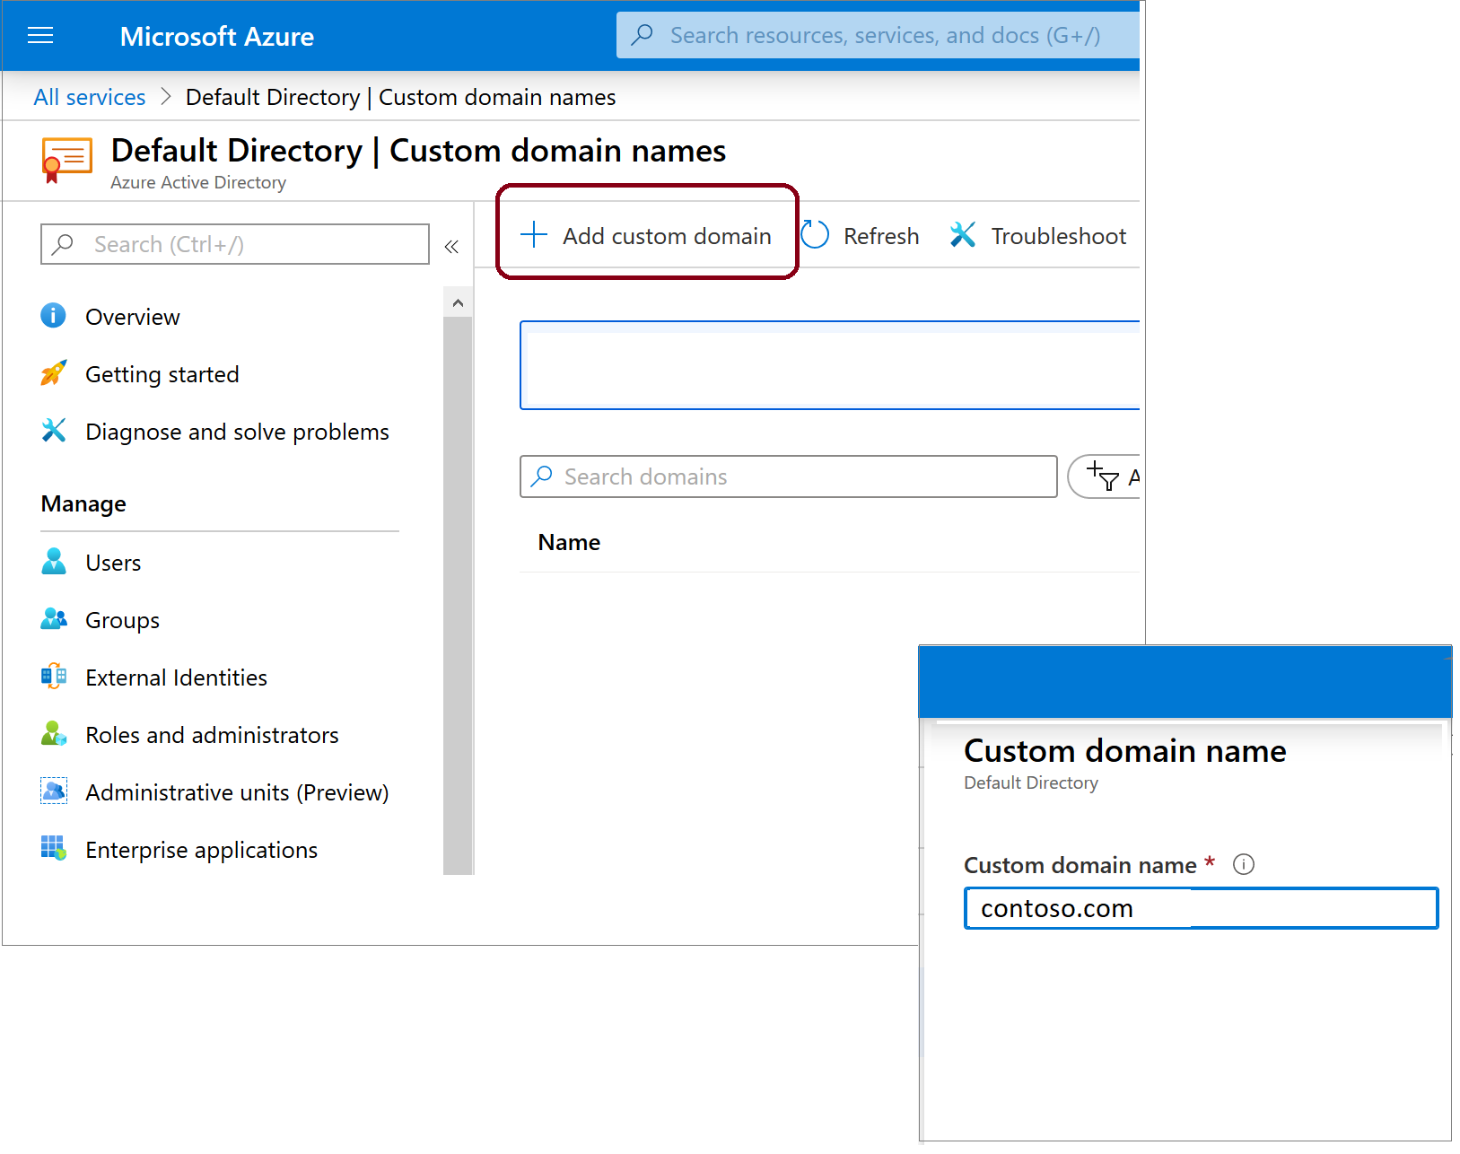
Domains and Custom Domains
Azure AD tenant domain names:
Initial (mandatory) with onmicrosoft.com suffix
Custom (optional)
Domain name management:
Requires global administrator privileges
Domain names are globally unique
Custom domain names require verification

Slide 24
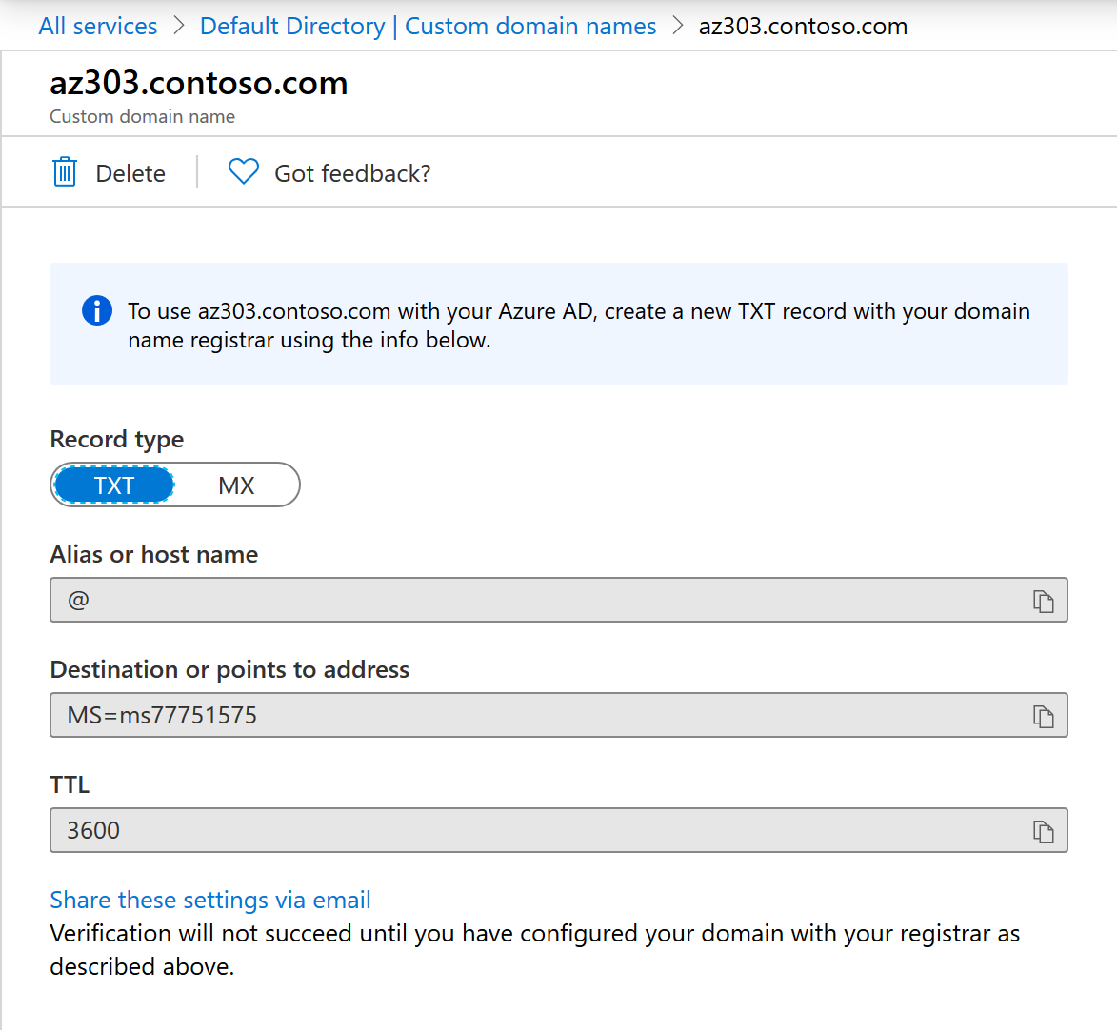
Verifying Custom Domain Names
A custom domain name is initially in an unverified state
To verify a custom domain, you must create a specific TXT or MX DNS record in the corresponding DNS zone

Slide 25
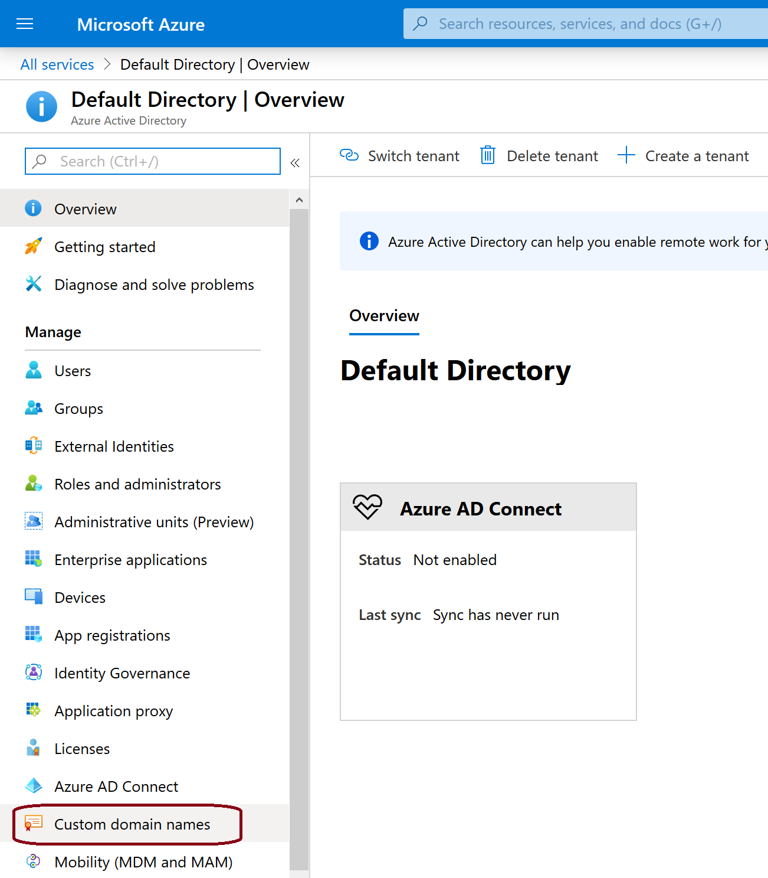
Add a Custom Domain Name to Azure AD
After you create your Azure AD tenant, you can add a custom domain name using Azure portal

Slide 26
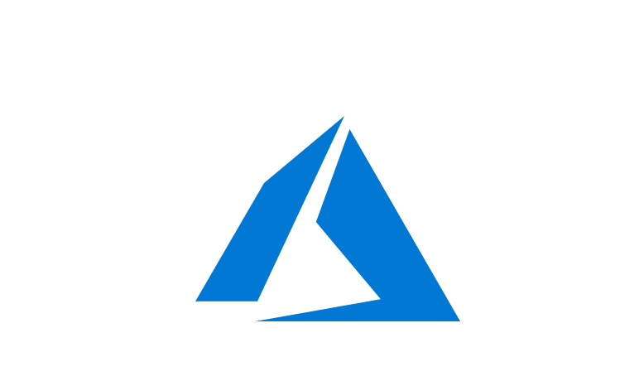
Configure MFA

Slide 27
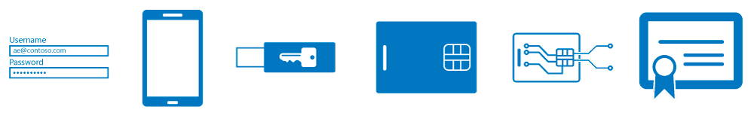
Multi-Factor Authentication (1 of 2)
Azure Multifactor Authentication (MFA) methods:
Something you know, typically a password
Something you have, such as a trusted device that is not easily duplicated, like a phone or hardware key
Something you are - biometrics like a fingerprint or face scan

Slide 28
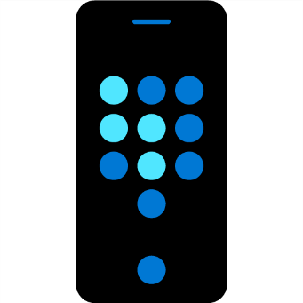
Multi-Factor Authentication (2 of 2)
Available verification methods:
Microsoft Authenticator app
OATH hardware token
SMS
Authentication methods:
Call to phone
Text message to phone
Notification through mobile app
Verification code from mobile app

Slide 29
Configure Guest Users in Azure AD

Slide 30

Prerequisites for Guest Users in Azure AD
You can invite anyone to collaborate with your organization by adding them to your directory as a guest user.
Guest users can sign in with their own work, school, or social identities.
To test guest-related scenarios, you need
An Azure AD user with a role that allows creating user accounts
A valid email account

Slide 31
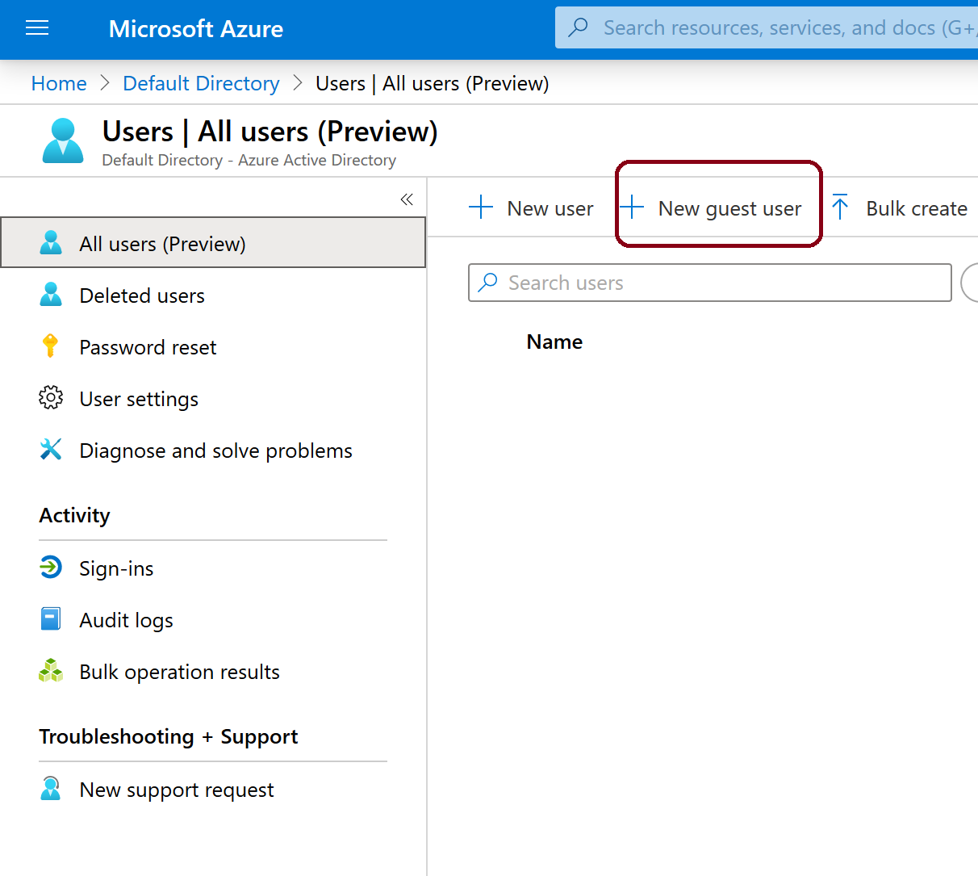
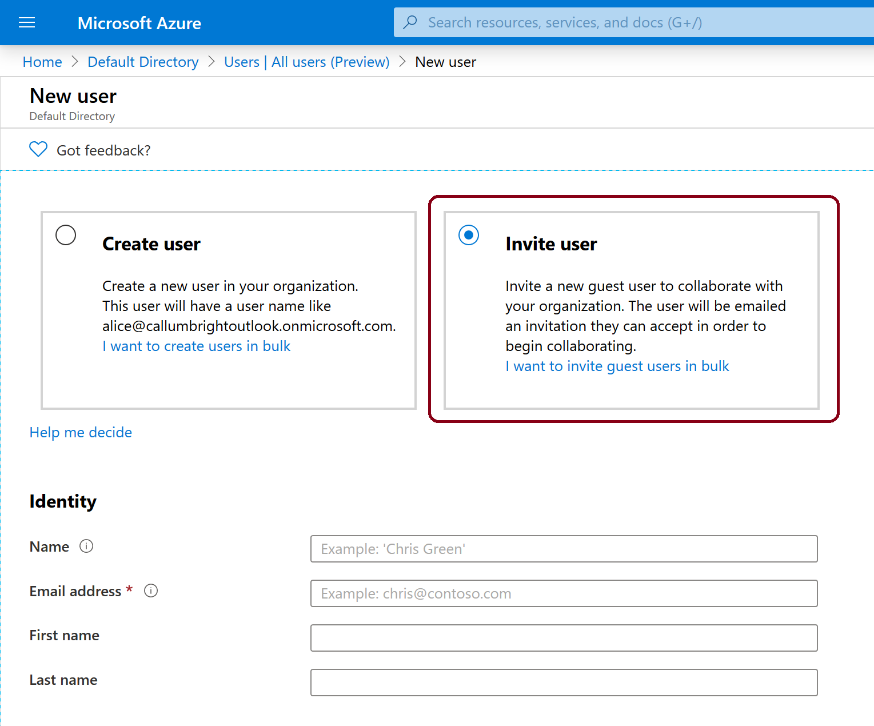
Add Guest Users to Azure AD
Sign into Azure portal and add a guest user

Slide 32
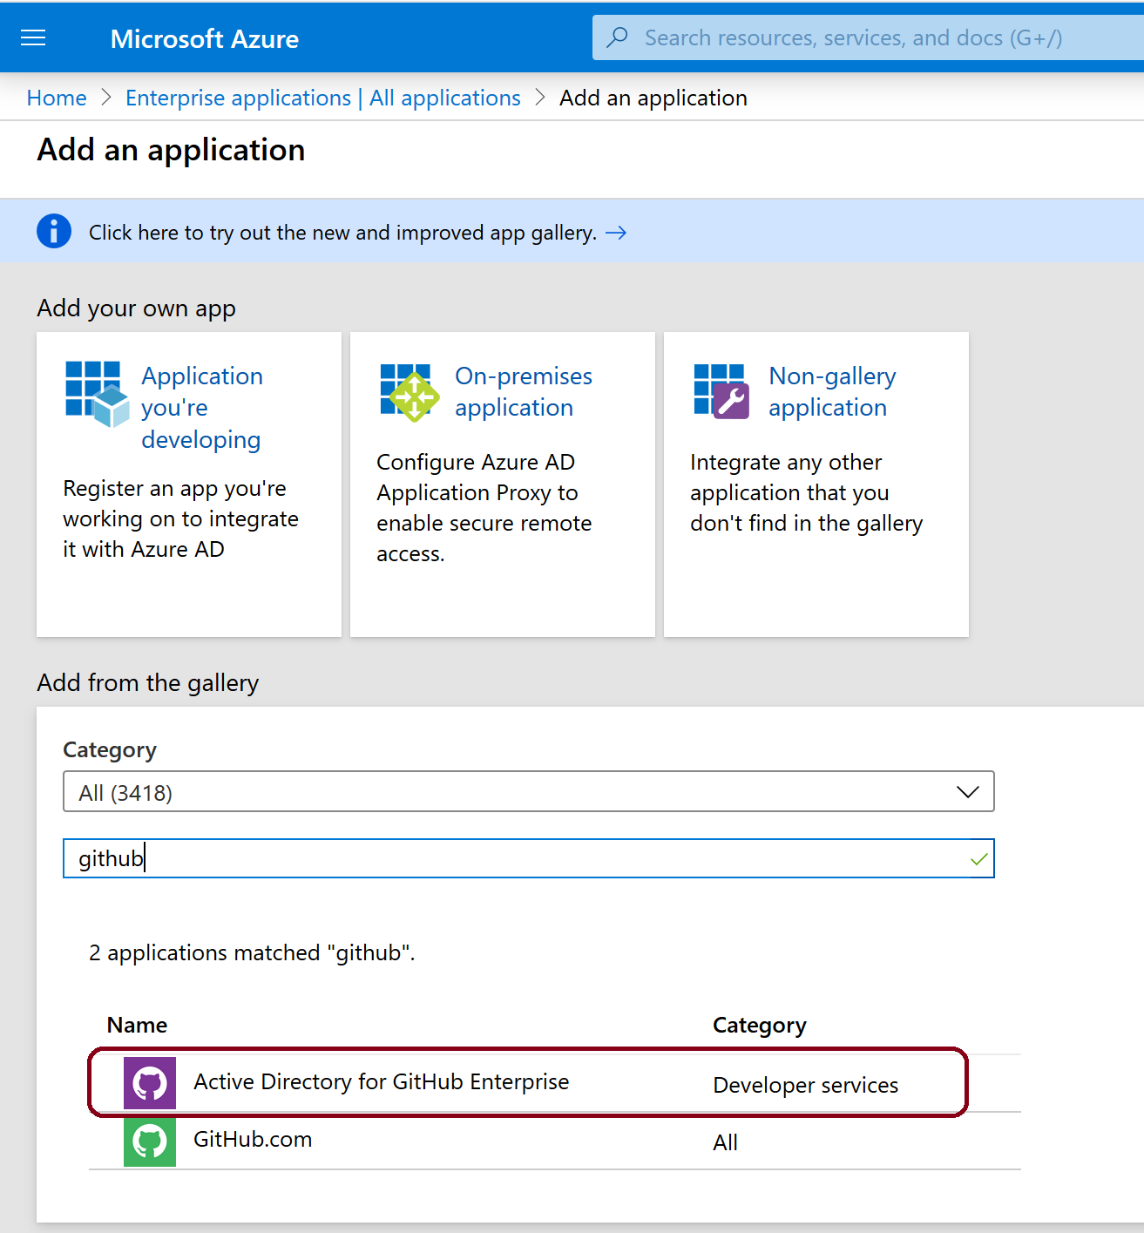
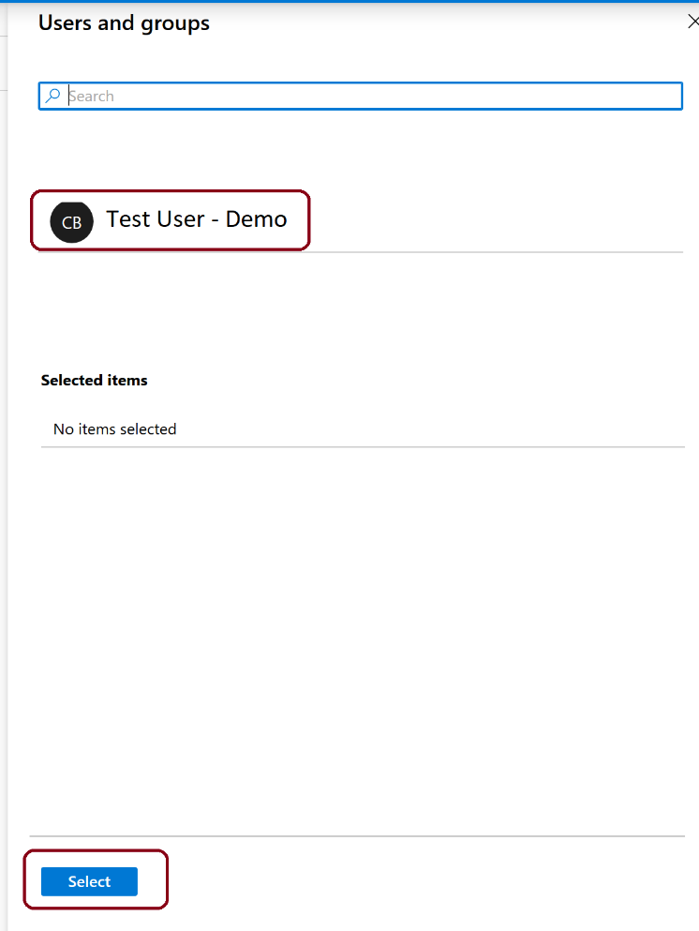
Assign an App to a Guest User
Add the Active Directory for GitHub Enterprise app to your test tenant and assign the test guest user to the app.

Slide 33
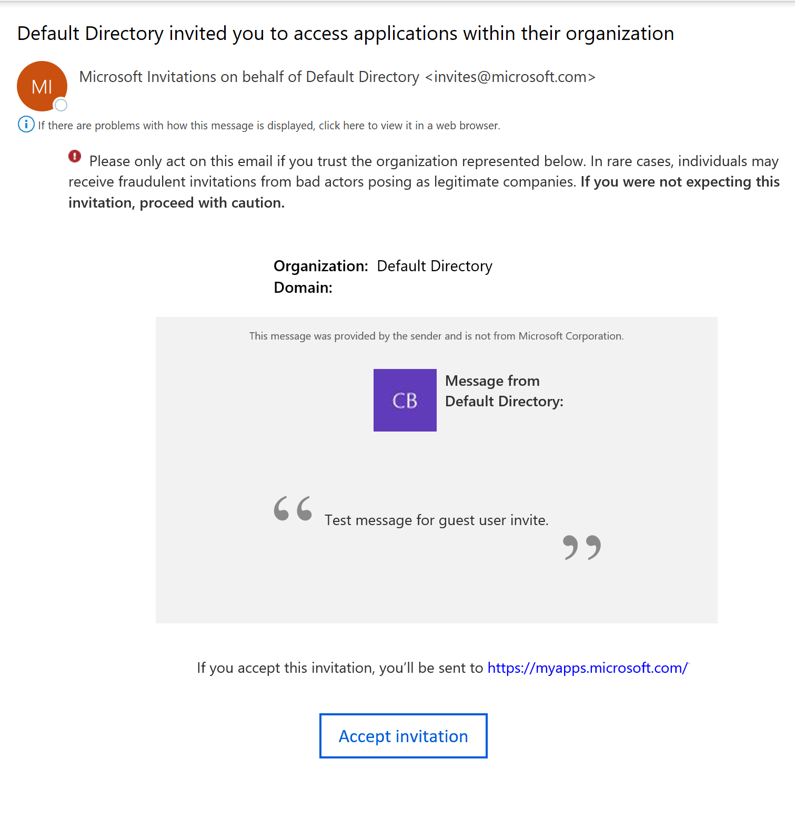
Accept the Guest User Invite
Sign-in to your test guest user's email account
In the inbox, locate the "You're invited" email
In the email body, select Get Started
Select Accept Invitation

Slide 34
Discussion: Users and Groups
How many AD do you have On-Prem?
How many Tenants should you have in the cloud?

Slide 35
Thanks!

